Slide 1
Army STANDARD TRAINING PACKAGE
Notes:
Select Note Pages contain instruction comments to assist with your presentation.
This Standard Training Package (STP) is current as of 21 October 2024. To ensure this is the most current version, please go to https://tjaglcs.army.mil/ and locate the STPs within the "Training" area/box of the tjaglcs site.

Slide 2
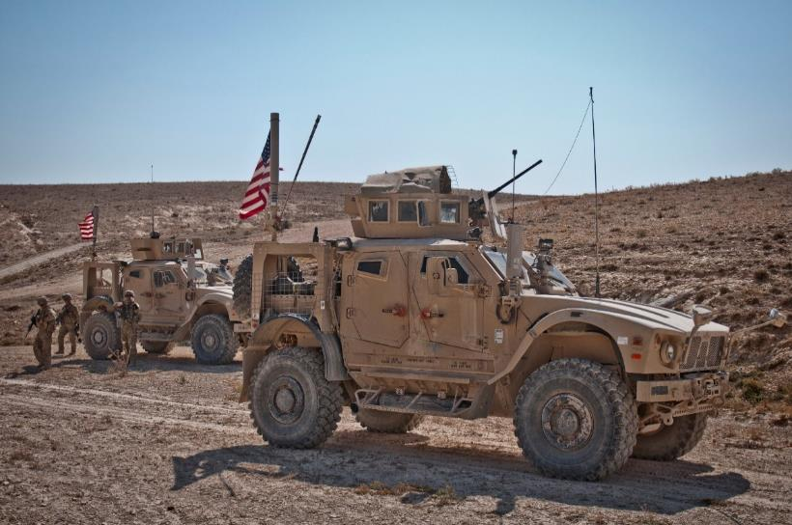
The Law of Armed Conflict
The Rules That Govern The Conduct Of Soldiers
In Military Operations
Notes:
Select Note Pages contain instruction comments to assist with your presentation.
This Standard Training Package (STP) is current as of 21 October 2024. To ensure this is the most current version, please go to https://tjaglcs.army.mil/ and locate the STPs within the "Training" area/box of the tjaglcs site.
The authors of this STP STRONGLY recommended that briefers review the DoD Law of War Manual (available at: http://www.dod.mil/dodgc/). The DoD LOW Manual is the current comprehensive DoD position on many nuanced areas of the law of war. The Law of War Manual is updated by the DoD Office of General Counsel and represents the legal views of the Department of Defense.
Briefers should also obtain and read in advance Chapter 2 of the Operational Law Handbook. In addition, obtain, review as needed, and have available copies of the Law of Armed Conflict Deskbook and Law of Armed Conflict Documentary Supplement. These publications are updated annually and provide a quick reference to prepare for and answer questions during presentations. They may be downloaded from JAG University (under the Library tab) and CLAMO (https://www.jagcnet.army.mil/CLAMO). In particular, Appendix A to Chapter 2 of the Operational Law Handbook provides a useful two-page summary for briefing tactical units.
Army Regulation (AR) 350-1, Army Training and Leader Development (10 December 2017), Table F-2, is the source document for the Soldier’s Rules and the scope of this STP. Table F-2 lists three levels of training (A, B, and C) for the law of war and detainee operations. This presentation helps with Level B training in MTOE units, conducted by a qualified Judge Advocate or Paralegal NCO per AR 350-1. It emphasizes the principles set forth in the Soldier’s Rules, as well as proper treatment of detainees to include the 5 Ss and T (search, segregate, silence, speed to a safe area, safeguard, and tag). It also stresses individual and command responsibility to establish adequate supervision and control processes to ensure proper treatment and prevent abuse of detainees.
Before providing training, trainers and Chiefs of Operational Law must consult AR 350-1, Table F-2, for additional guidance on training objectives, qualified trainers, and tailoring and integrating training to particular unit missions and activities.

Slide 3
Training Objectives
Understand the need for the Law of Armed Conflict (LOAC).
Understand the legal sources for the LOAC.
Identify the LOAC Basic Principles.
Military Necessity.
Discrimination or Distinction.
Proportionality.
Humanity (or Unnecessary Suffering).
Apply the Ten LOAC Standards – The Soldier’s Rules.
Notes:
Instructor Comments
The Geneva Conventions of 1949 require that all members of each ratifying nation’s military forces be trained in the LOAC.
Paragraph 5.8.1 of DEPARTMENT OF DEFENSE DIRECTIVE 2311.01E, DOD LAW OF WAR PROGRAM (9 May 2006, Change 1 15 Nov 2010) [hereinafter DODD 2311.01E] directs the Secretary of the Army to “provide directives, publications, instructions, and training so the principles and rules of the law of war will be known to members of [the Army]. Such knowledge will be commensurate with each individual’s duties and responsibilities.]

Slide 4
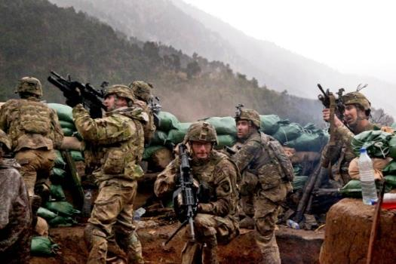
What Is The LOAC?
LOAC Legal Sources:
Hague Regulations.
Geneva Conventions.
Other International Treaties.
Customary International Law.
These sources reflect U.S. and international values.
Notes:
Instructor Comments
The “Law of War” (LOW) is “that part of international law that regulates the conduct of armed hostilities . . . The law of war encompasses all international law for the conduct of hostilities binding on the United States or its individual citizens, including treaties and international agreements to which the United States is a party, and applicable customary international law.” DoDD 2311.01E, para. 3.1.
The law of war is frequently called the law of armed conflict, or LOAC, because many of the hostile situations we face around the world are not declared wars like World War I or II. Today I will use the term LOAC to refer to the laws of war.
Where does the LOAC come from? It includes treaties our nation signs and ratifies, and customary laws we accept as binding and always follow, no matter what. These are national commitments to both U.S. and international values.
The Hague Regulations (HR) of 1907 include basic regulations for targeting and treatment of civilians that the U.S. still follows today. (They are an Annex to Hague Convention No. IV Respecting the Laws and Customs of War on Land, Oct. 18, 1907, 36 Stat. 2277, 1 Bevans 631).
The four Geneva Conventions of 1949 have been ratified by all 193 members of the United Nations and require nations to respect and protect the wounded and sick in combat or at sea, medical personnel and hospitals, prisoners of war, and civilians and their property.
The U.S. has signed or ratified many other international treaties governing certain weapons and protection of cultural property (like national heritage sites). We also follow some rules even without a treaty as a matter of custom (for example, rules on targeting).

Slide 5
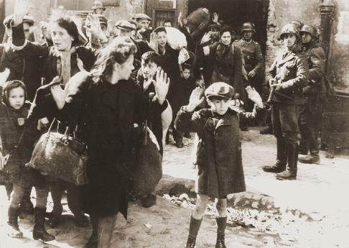
Why Do We Need The LOAC?
To assist Commanders and Soldiers in mission accomplishment.
To regulate the use of force and prohibit unlawful conduct.
To protect against unnecessary suffering and excessive collateral damage.
To promote the humane treatment of noncombatants, wounded and sick, and civilians.
Notes:
Instructor Comments
Paragraph 2 of the U.S. DEP’T OF ARMY, FIELD MANUAL 6-27, THE COMMANDER’S HANDBOO ON THE LAW OF LAND WARFARE (August 2019) [hereinafter FM 6-27], states that the LOAC is “inspired by the desire to diminish the evils of war by:
a. Protecting both combatants and noncombatants from unnecessary suffering;
b. Safeguarding certain fundamental human rights of persons who fall into the hands of the enemy, particularly prisoners of war, the wounded and sick, and civilians; and
c. Facilitating the restoration of peace.”
It is DoD policy that “members of the DoD Components comply with the law of war during all armed conflicts, however such conflicts are characterized, and in all other military operations.” DoDD 2311.01E, para. 4.1.

Slide 6
Why Do You Need To Follow The LOAC?
Adherence promotes:
A disciplined, more effective fighting force.
Support for U.S. operations both at home and abroad.
An earlier end to hostilities.
All sides respecting the rules of warfare.
It’s the right thing to do:
Moral Courage and Self Discipline are the hallmarks of a professional warrior.
It’s the law:
Violations can create an international incident.
War crimes are serious charges with real victims.
War crimes embarrass the United States & limit policy options.
Notes:
Instructor Comments
QUESTION: If the other side ignores the rules, what should we do? [We still follow them, and report their violation to our chain of command!]
From the DoD Law of War Manual, Foreword:
The law of war is part of who we are. George Washington, as Commander in Chief of the Continental Army, agreed with his British adversary that the Revolutionary War would be “carried on agreeable to the rules which humanity formed” and “to prevent or punish every breach of the rules of war within the sphere of our respective commands.” During the Civil War, President Lincoln approved a set of “Instructions for the Government of the Armies of the United States in the Field,” which inspired other countries to adopt similar codes for their armed forces, and which served as a template for international codifications of the law of war….The law of war is a part of our military heritage, and obeying it is the right thing to do. But we also know that the law of war poses no obstacle to fighting well and prevailing. Nations have developed the law of war to be fundamentally consistent with the military doctrines that are the basis for effective combat operations. For example, the self-control needed to refrain from violations of the law of war under the stresses of combat is the same good order and discipline necessary to operate cohesively and victoriously in battle. Similarly, the law of war’s prohibitions on torture and unnecessary destruction are consistent with the practical insight that such actions ultimately frustrate rather than accomplish the mission.

Slide 7
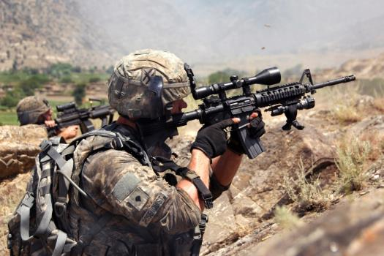
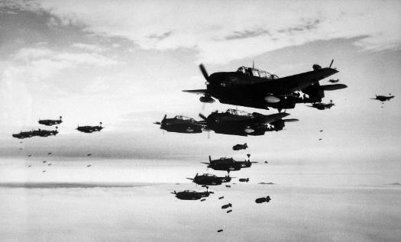
LOAC – The Basic Principles
Military Necessity
Distinction
Proportionality
Humanity (Unnecessary Suffering)
Notes:
Instructor Comments
These are the four cornerstone principles of the LOAC. The first principle and the last principle complement each other—the need to use military force versus humanitarian concern for the civilian population. The middle two principles are more tactical—shooting at the enemy, not civilians, and balancing military need versus civilian death, injury, and property damage. Let’s discuss each in more detail.

Slide 8
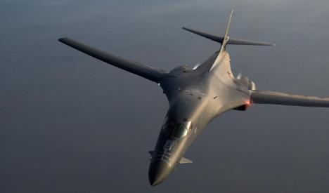
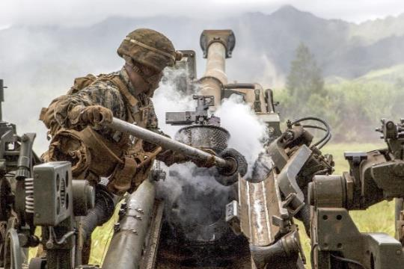
Military Necessity
Military Necessity may be defined as the principle that justifies the use of all measures needed to defeat the enemy as quickly and efficiently as possible that are not prohibited by the law of war.
Military Necessity justifies actions, such as destroying and seizing persons and property.
Notes:
Instructor Comments
Defined in the DoD Law of War Manual at para 2.2.
For over 150 years (since the U.S. Civil War), U.S. armed forces have followed the principle of military necessity. It requires two things: first, that a use of force is not illegal, and second, that a use of force is for a valid military purpose. The LOAC absolutely prohibits certain acts, such as killing prisoners of war, or taking civilian hostages, no matter how much it seems necessary. For all other uses of force, there must be a valid military purpose.
FM 6-27, para. 1-23 defines military necessity as “the principle that justifies the use of all measures needed to defeat the enemy as quickly and efficiently as possible that are not prohibited by LOAC.”

Slide 9
Military Necessity
Military Force must be directed at LEGITIMATE MILITARY OBJECTIVES.
Military necessity is NOT a defense for acts expressly prohibited by international law.
Use your best judgment, based on information reasonably available under the circumstances
Notes:
Instructor Comments
Recommend you emphasize the points that follow.
This is a common sense principle with limits. When you go out on mission, know what your objective is and how much force your commander authorizes you to use. Your actions can’t be illegal, and they must be justified.
Military necessity justifies actions, such as destroying and seizing persons and property. Thus, military necessity underlies law of war concepts that explain when persons and property may be the object of attack. DoD Law of War Manual para. 2.2.1. These concepts will be discussed in detail later, under the principle of distinction.
When making decisions, use your best judgment. It is U.S. policy that “any decision by any military commander, military personnel, or any other person responsible for planning, authorizing, or executing military action shall only be judged on the basis of that person’s assessment of the information reasonably available on to the person at the time the person planned, authorized, or executed the action under review, and shall not be judged on the basis of information that comes to lights after the action under review was taken.” U.S. Understandings, para. (1)(A), Protocol on Prohibitions or Restriction on the Use of Mines, Booby-Traps and Other Devices as amended on 3 May 1996, to the Certain Conventional Weapons (CCW) treaty. [The U.S. Senate has included this language when ratifying several recent LOAC treaties, and it reflects the long-standing U.S. policy dating back to World War II, known as the Rendulic Rule.
Always remember that no matter how urgent the situation, military necessity is not a defense for violating the law. In summary, your actions must not be illegal, and they must be justified.

Slide 10
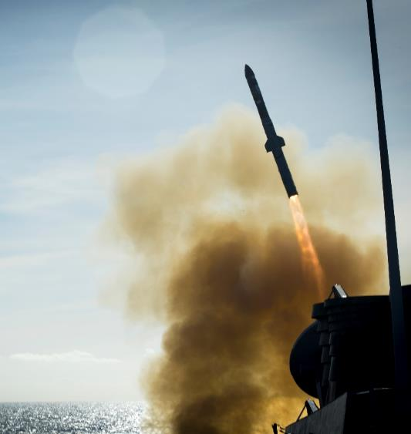
Distinction or Discrimination
THE RULE: Soldiers must distinguish:
Combatants from non-combatants and civilians.
Military objectives from protected property or protected places.
Related Rules: When conducting military operations, Soldiers must ensure that:
They separate themselves from civilians and civilian objects.
Effects distinguish between the civilian population/objects and combatants/military objectives.
Force is directed solely against combatants and military objectives.
Notes:
Instructor Comments
Distinction, sometimes called discrimination, obliges parties to a conflict to distinguish principally between the armed forces and the civilian population, and between unprotected and protected objects. Distinction may be understood as encompassing two sets of reinforcing duties. Parties to a conflict must apply a framework of legal classes for persons and objects by: (1) discriminating
in conducting attacks against the enemy; and (2) distinguishing a party’s own persons and objects. DoD LoWM para 2.5
Soldiers have a duty to conduct operations so as to minimize the likelihood of civilians being attacked by enemy forces.
Soldiers also have a duty not to intentionally occupy, absent imperative military necessity, certain civilian objects such as mosques, churches, and cultural sites. This area of the law is subject to detailed rules. Consult paragraphs 5.16 through 5.18 of the DoD Law of War Manual for details.
Your Rules of Engagement may provide more specific guidance tailored to local cultural circumstances.

Slide 11
Proportionality
THE RULE: Anticipated civilian death, injury, and property damage (collateral damage) from an attack must not be excessive in relation to the concrete and direct military advantage gained.
PRECAUTIONS IN ATTACK:
Take feasible precautions to minimize anticipated civilian death, injury, and property damage
Unless circumstances do not permit, effective advance warning must be given of an attack that may affect the civilian population
Notes:
Instructor Comments
PROPORTIONALITY: “[t]he LOAC principle requiring combatants to refrain from attacks in which the expected loss or injury to civilians and damage to civilian objects incidental to such attacks would be excessive in relation to the concrete and direct military advantage expected to be gained.” FM 6-27, para. 1-44. It is a method for commanders to assess their obligations as to the law of armed conflict principle of distinction, while avoiding indiscriminate attacks.
Emphasize:
Unavoidable
Not a violation of international law
May not be excessive in relation to anticipated military advantage
PRECAUTIONS: Before attacking, always consider any reasonably available information about the target and collateral damage. Take steps to minimize civilian deaths, injuries, and property damage by confirming intelligence, choosing appropriate weapons and tactics, selecting the time and manner of attack, and using processes like collateral damage estimation (as appropriate to the situation) or other approved TTPs. Particularly when civilians are close to military objectives, or during aerial bombardments, consider issuing effective advance warnings, unless the attack is a surprise assault and a warning would compromise it.

Slide 12
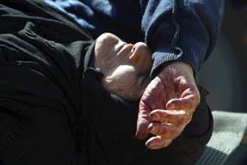
Humanity or Unnecessary Suffering
The Rule:
It is forbidden for Soldiers to use arms, projectiles, or material CALCULATED to cause UNNECESSARY SUFFERING.
The rule prohibits weapons which cause unnecessary suffering, and also the use of lawful weapons in a manner designed to cause unnecessary suffering.
Notes:
Instructor Comments
Humanity may be defined as the principle that forbids the infliction of suffering, injury, or destruction unnecessary to accomplish a legitimate military purpose. DoD LoWM para 2.3
Humanity is related to military necessity, and these principles logically complement one another. Humanity may be viewed as the logical inverse of the principle of military necessity. If certain necessary actions are justified, then certain unnecessary actions are prohibited. The principle of humanity is an example of how the concept of necessity can function as a limitation as well as a justification. Because humanity forbids those actions that are unnecessary, the principle of humanity is not in tension with military effectiveness, but instead reinforces military effectiveness.
All issued military weapons and ammunition are subject to a legal review for compliance with the LOAC.
There are three types of prohibitions:
1. The U.S. and many other nations have agreed never to use certain weapons in warfare, as they are inherently inhumane. Example: glass-filled projectiles.
2. The U.S. and many other nations have also agreed to restrict use of some weapons systems, to better protect civilians and Soldiers. Examples: Incendiary weapons, fragmenting bullets.
3. The U.S. and many other nations prohibit the use of any weapon in a manner CALCULATED to cause UNNECESSARY (or gratuitous) SUFFERING that has no military purpose. Example: A sniper aiming deliberately for one kneecap, then the other, purely to see the victim squirm.
Three notes:
1. The U.S. always conducts a legal review of weapons before they are fielded. Make sure you know the rules regarding every fielded weapon. Seek advance approval from higher for any modification that changes the design or intended use of a weapon.
2. NECESSARY suffering is a fact of battlefield life. This principle forbids UNNECESSARY suffering caused by illegal or improperly modified or used weapons.
3. HUMANITY is a related principle. It is the desire to minimize the overall violence of war. However, do not confuse it with distinction (between combatants and civilians) or proportionality (balancing military necessity against collateral civilian death, injury, and damage).

Slide 13
Honor
THE RULE:
Fairness in offense and defense
Mutual respect between opposing forces.
Honor forbids resort to means, expedients or conduct that would constitute a breach of trust with the enemy.
Honor requires Soldiers to comply with the law of war in good faith
Notes:
Instructor Comments
The principle of Honor provides the foundation for the other LOAC principles, and embodies the underlying sense of obligation to abide by the LOAC that commanders must instill in their Soldiers. DoD LoWM para 2.6
In demanding a certain mutual respect between opposing forces, honor also reflects the premise that combatants are a common class of professionals who have undertaken to comport themselves honorably. While an enemy force may not abide by the principles of the LOAC or behave honorably, it places the emphasis on the wrong actor. The United States Army is comprised of professional Soldiers, and our enemies’ lack of honor only serves to highlight why it is so important that we abide by a higher standard.

Slide 14
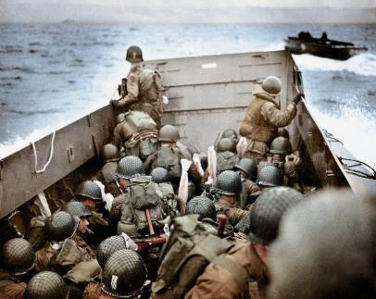
Ten LOAC Standards The Soldier’s Rules
Soldiers fight only combatants.
Soldiers do not harm enemies who surrender. They disarm them and turn them over to their superior.
Soldiers do not kill or torture personnel in their custody.
Soldiers collect and care for the wounded, whether friend or foe.
Soldiers do not attack protected persons and protected places.
Soldiers destroy no more than the mission requires.
Soldiers treat civilians humanely.
Soldiers do not steal. Soldiers respect private property and possessions.
Soldiers should do their best to prevent violations of LOAC.
Soldiers report all violations of LOAC to their superiors.
Notes:
Instructor Comments
The Soldier’s Rules, found in AR 350-1, Table F-2, are a useful summary of the most fundamental LOAC rules. They reflect the four major LOAC principles: Military Necessity, Unnecessary Suffering/Humanity, Distinction/Discrimination, and Proportionality; as well as every Soldier’s obligation to treat all detainees, civilians, and their property with respect, and to prevent and report violations of the LOAC.
The Soldier’s Rules do not include every rule found in the LOAC, but they do provide a basic LOAC foundation that can be applied in almost any U.S. military operation, as required by DoDD 2311.01E.

Slide 15
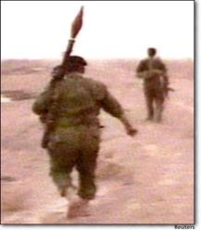
#1: Fight Only Combatants
Notes:
Instructor Comments
Combatants are the military forces of the enemy. They include (Law of War Manual para. 5.7.2):
Members of the Armed Forces of a State
Members of Militia and Volunteer Corps
Participants in a levee en masse
Persons belonging to Non-State Armed Groups
Leaders whose responsibilities include the operational command and control of the armed forces or of a non-State armed group
Combatants may be privileged or unprivileged. The fact that a combatant is unprivileged does NOT, however, imply that unprivileged belligerents have no rights. At a minimum, in any type of conflict, they are entitled to humane treatment and the customary international law protections found in Common Article 3 of the Geneva Conventions and (in international armed conflict) Article 75 of Additional Protocol I.
Under LOAC, there are both status-based combatants (for example, the enemy’s military forces in uniform), and conduct-based combatants (for example, someone who starts shooting at you on the battlefield, or otherwise demonstrates hostile act/hostile intent).
The Standing Rules of Engagement (ROE), and supplemental mission-specific ROE, frequently provide more specific guidance on who the United States considers an enemy combatant. [Instructor: Tailor discussion on this and the next slide to threats your unit will likely face].
REFERENCES: DoD Law of War Manual, Chapters 4 and 5; Chairman of the Joint Chiefs Instruction (CJCSI) 3121.01B [soon to be 3121.01C], Standing Rules of Engagement (SROE)/Standing Rules for the Use of Force (SRUF) for U.S. Forces (13 June 2005) ; and Chapters 2 and 5 of the Operational Law Handbook.

Slide 16
#1: Fight Only Combatants
“Combatant”: Persons subject to attack because they are members of a nation’s armed forces or are members of an armed group that is a party to the conflict.
Civilians are protected from attack unless they directly participate in hostilities.
Persons subject to attack may include:
- Members of the armed forces of a State
- Members of militia and volunteer corps
- Members of non-State armed groups
US Practice under Rules of Engagement (ROE):
- Status based: Persons “declared” hostile.
- Conduct based: Persons committing a Hostile Act or Showing Hostile Intent.
Notes:
Instructor Comments
The relationship between status under the laws of war and status under the rules of engagement (ROE) may be confusing. Ensure you keep these concepts separate and understand the relationship between the two.
Refer to the DOD LOW Manual. Additional categories of combatants include participants in a levee en masse and leaders whose responsibilities include the operational command and control of the armed forces or of a non-State armed group. See DoD LoWM para. 5.7.2.
Any combatant belonging to a declared hostile force may be engaged with force at any time.
Unprivileged Belligerents are either persons who have lost their lawful combatant status due to their failure to comply with LOAC or are persons who have forfeited one or more of the protections of civilian status by engaging in hostilities. DoD LoWM para 4.3.4.
Persons can also legitimately be targeted due to their conduct. For example, an individual who takes a direct part in hostilities and who does not meet the LOAC criteria of a lawful combatant (for example, a civilian planting IEDs) is an unprivileged belligerent—they have no privilege to use lethal force. An unprivileged belligerent may be targeted, is not entitled to POW status if captured, and may be tried for their crimes and does not enjoy “combatant immunity.” However, the fact that a combatant is unprivileged does NOT imply that unprivileged belligerents have no rights. At a minimum, in any type of conflict, they are entitled to humane treatment and the customary international law protections found in Common Article 3 of the Geneva Conventions and (in international armed conflict) Article 75 of Additional Protocol I.
Explain “Hostile Act” and “Hostile Intent” – Use Examples
Hostile Act: An attack or other use of force against the United States, U.S. forces, and, in certain circumstances, U.S. nationals, their property, U.S. commercial assets, and/or other designated non-U.S. forces, foreign nationals and their property. It is also force used directly to preclude or impede the mission and/or duties of U.S. forces, including the recovery of U.S. personnel and vital U.S. Government property. A hostile act triggers the right to use necessary and proportionate force in self defense to deter, neutralize, or destroy the threat.
Hostile Intent: The threat of imminent use of force against the United States, U.S. forces, or other designated persons and property. It is also the threat of force used directly to preclude or impede the mission and/or duties of U.S. forces, including the recovery of U.S. personnel and vital U.S. Government property. When hostile intent is present, the right exists to use proportional force in self defense to deter, neutralize, or destroy the threat.
Civilians – refer to the DOD LOW Manual – Civilians may not be made the object of attack unless they take Direct Part in Hostilities.
Commanders have an inherent right to defend their units, and a Soldier’s right to self-defense is a subset of unit self-defense. The inherent right of self defense provides U.S. armed forces with the ability to respond, with measured force, whenever they come under attack. The principle of military necessity underlies the justification for using force—i.e., unit or individual self-defense to preserve the ability to fight and win in the future.

Slide 17
#2: Do Not Harm Enemies Who Surrender. Disarm Them and Turn Them Over To Your Superior.
Follow the 5 S’s and T.
Treat Detainees Humanely
Respect and Protect Them
Notes:
Instructor Comments
It is a fundamental purpose of the LOAC to safeguard certain fundamental rights of persons who fall into the hands of the armed forces, particularly prisoners or war, detainees, and internees. Treating these individuals humanely is required by international and U.S. law, provides an incentive for others to surrender, and lessens their will to resist. If our enemies believe they have no incentive to surrender, because they feel that they will not be treated humanely, they are more likely to resist and fight to the death.

Slide 18
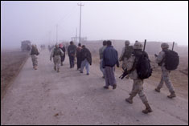
Five S’s and T for Detainees
Search: Disarm
Silence
Segregate
- By military rank
- Civilians from Military
- Military from Militia
Safeguard: Protect from further harm
Speed to rear: Turn over to proper holding facility for processing
Tag: Document capture details
Notes:
Instructor Comments
The protection and treatment rights, as well as the obligation to treat captives humanely, attach at the moment they are taken into captivity. Geneva Convention Relative to the Treatment of Prisoners of War Art. 5, August 12, 1949, 6 U.S.T. 3316, 75 U.N.T.S. 135 [hereinafter GC III].
For a list of practical considerations in detainee operations, as well as more information on the five S’s and T, see Appendix A to Chapter 11, “Detainee Operations”, in the Operational Law Handbook.

Slide 19
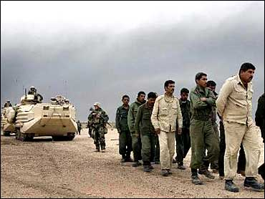
#3: Do Not Kill Or Torture Personnel in your Custody
Killing or Torturing detained personnel is a crime under both international and domestic law.
Humane treatment is the minimum standard for ALL detained personnel regardless of status.
You may conduct tactical questioning near the time and place of capture.
ONLY trained interrogators conduct interrogations or extended questioning.
Notes:
Instructor Comments
Killing or torturing detainees, or lesser forms of mistreatment, are crimes under the LOAC and the Uniform Code of Military Justice. If committed by civilians, these crimes can be prosecuted under federal law.
Humane treatment is the minimum standard for all detainees. We will talk about this on the next slide.
Field Manual 2-22.3, Human Intelligence Collection Operations (6 Sep 2006) and the Detainee Treatment Act of 2005 mandate that ONLY trained and certified interrogators (i.e., those who have been to a Defense Intelligence Agency-approved interrogator course) can conduct interrogations. FM 2-22.3 defines interrogations as “the systematic effort to procure information to answer specific collection requirements by direct and indirect questioning techniques of a person who is in the custody of the forces conducting the questioning.”
Soldiers in the field CAN conduct tactical questioning, which FM 2-22.3 defines as “the expedient initial questioning for information of immediate tactical value. (DoD Directive 3115.09 defines it as “The field-expedient initial questioning for information of immediate tactical value of a captured or detained person at or near the point of capture and before the individual is placed in a detention facility.” Tactical questioning is limited to direct questioning. Tactical questioning should be short, with at least two Soldiers present.
Torture is not only unlawful, but studies show it frequently produces unreliable information and leaves lasting psychological scars on those who commit it. U.S. forces do not torture detainees, ever.
For more information on tactical questioning vs. interrogations, see Chapter 6, “Intelligence Law and Interrogation Operations”, in the Operational Law Handbook.

Slide 20
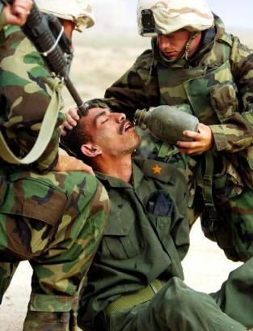
Treat Detainees Humanely
Provide Humane Treatment:
Medical Treatment
Food
Water
Shelter
Basic Hygiene Care
Clothing
Notes:
Instructor Comments
Geneva Convention III, Art. 13, provides for the Humane Treatment of prisoners of war (PWs). Regardless of status (Detainee, PW, Internee), always provide humane treatment to individuals in your custody.
Humane Treatment of all detainees is required in all military operations. See Common Article 3 of the 1949 Geneva Conventions; Para. 1-5.a. of Army Regulation (AR) 190-8, Enemy Prisoners of War, Retained Personnel, Civilian Internees, and Other Detainees (1 Oct 1997); and Executive Order 13,567 and its Fact Sheet, which require humane treatment of detainees across the spectrum of conflict situations.
For further information on the humane treatment standard, see Chapter 12, “Detainee Operations”, in the Operational Law Handbook.

Slide 21
Respect and Protect Detainees
Respect and Protect Detainees:
Protect from retaliation or retribution.
Protect from public humiliation or curiosity.
Respect for person, honor, cultural beliefs.
Civilian employees and contractors must follow the same rules:
The requirement to treat detainees humanely applies to all U.S. military, civilian employees, and contractors (whether DoD or not).
U.S. does not transfer detainees to foreign control if the detainees are likely to be tortured or killed.
Notes:
Instructor Comments
Protect detained personnel from violence, intimidation, insults, and public curiosity. GPW, Art. 13. Photographing an enemy prisoner of war (EPW) for the purpose of aiding in his identification is not a violation of the LOAC. However, photos taken or “staged” to degrade or humiliate an EPW serve no lawful military purpose.
DOD civilian employees and contractor personnel and all federal employees and civilian contractor personnel performing missions, such as handling and interrogations of DOD detained personnel at DOD facilities, must comply with international and domestic law. This includes, but is not limited to, US Treaty obligations, the Military Extraterritorial Jurisdiction Act (MEJA) as amended by the National Defense Authorization Act for Fiscal Year 2005 (see Section 3267(1)(A) of Title 18), the War Crimes Act, 18 U.S.C. 2441 (2000), and even prosecution under the Uniform Code of Military Justice (Article 2(a)(10) extends jurisdiction to some civilians accompanying the forces).
Article 3 of the Convention Against Torture and Other Cruel, Inhuman, or Degrading Punishment (CAT), which the U.S. has signed and ratified, requires that “no State Party shall expel, return (“refouler”, or extradite a person to another State where they are substantial grounds for believing that he would be in danger of being subjected to torture.” For a time, the U.S. halted detainee transfers to certain facilities and units in Afghanistan in 2011-12 due to allegations of detainee mistreatment by Afghan authorities. If you see or hear credible information that foreign forces are mistreating detainees, report this to your chain of command.

Slide 22
Respect Detained Females
Females will be treated with respect:
Protected from sexual assault.
Females are entitled to respect for their persons and their honor.
Notes:
Instructor Comments
Females shall be treated with all the regard due to their sex and shall in all cases benefit by treatment as favorable as that granted to men. Geneva Convention for the Amelioration of the Condition of the Wounded and Sick in the Armed Forces in the Field Art. 12, Aug. 12, 1949, 6 U.S.T. 3114, 75 U.N.T.S. 31 [hereinafter GC I]. Depicted here: Marines of the Female Searching Force RCT 1 (Regimental Combat Team 1), search an Iraqi woman at a checkpoint leading into the heavily guarded city of Fallujah, Iraq on Sunday, February 6, 2005.

Slide 23
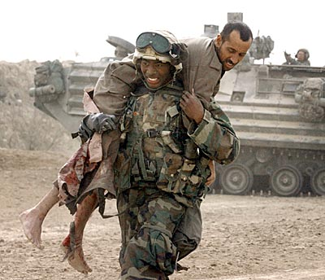
#4, Collect And Care For The Wounded, Whether Friend or Foe
The LOAC requires the same level of care for friend and foe:
Once they are out of the fight, take care of them.
Triage the most seriously wounded -- whether friendly or enemy.
Safeguard from further attack.
Notes:
Instructor Comments
Individuals who are sick or wounded, and who cease to fight, shall be treated humanely, without any adverse distinction founded on race, nationality, religion, sex, or any other similar criteria. They are to be respected and protected in all circumstances. GC I, Arts. 12 & 13.
Instruction note: The immediacy of this requirement depends on mission execution, self-defense/defense of unit members, and other operational necessities present when collection and care of wounded is needed. Use common sense and your best judgment based on the tactical situation and resources available.
Per Appendix A of ATP 4-02.3, the order of treatment for triage is Immediate (life/limb), Delayed (severe but can wait), Minimal (minor, ambulatory), Expectant (extreme injury, palliative care).

Slide 24
Mercy Killings are Illegal
'Mercy Killer' GI Gets Three Years BAGHDAD, Dec. 11, 2004 (CBS/AP)
- A U.S. soldier was sentenced to three years in prison after pleading guilty to killing a severely wounded Iraqi teenager
- The soldier also received a reduction in rank to private, forfeiture of wages and a dishonorable discharge. - He pleaded guilty to one count of unpremeditated murder and one count of soliciting another soldier to commit unpremeditated murder. - The charges relate to the Aug. 18 killing of a 16-year-old Iraqi male found in a burning truck with severe abdominal wounds sustained during clashes in Baghdad's Sadr City, an impoverished neighborhood that was the scene of fierce fighting between U.S. forces and Shiite rebels loyal to anti-U.S. cleric Muqtada al-Sadr.
Notes:
Instructor Comments
There is no such thing as a “mercy killing” in the LOAC. You have a duty to attempt to render or provide medical treatment to the sick and wounded.
In this case, the Convening Authority reduced the sentence to confinement for a period of one year.

Slide 25
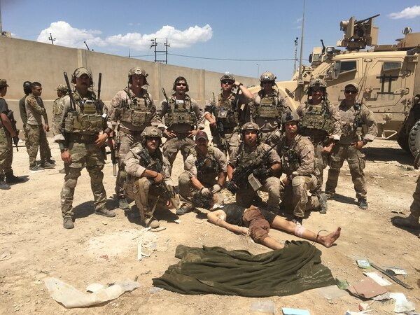
Respect the Dead
The Obligation to collect & protect the wounded extends to the dead.
Mutilation or desecration of dead bodies is a violation of the LOAC.
Notes:
Instructor Comments
Recent examples include posing with a dead prisoner's body on the battlefield.

Slide 26
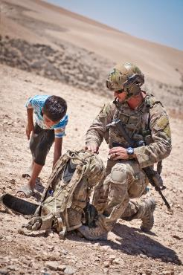
#5: Do Not Attack Protected Persons And Protected Places
Protected Persons.
Intentional targeting generally prohibited.
Protected Places.
Civilian objects protected from intentional attack.
Military purpose/military necessity analysis.
Incomplete intelligence & civilian casualties.
Notes:
Instructor Comments
Protected Persons. The law of war generally prohibits the intentional targeting of protected persons, such as civilians and medical/religious personnel, under any circumstances.
Protected Places. In general, civilian objects, such as hospitals, churches and mosques, are protected from intentional attack or destruction. However, objects may be attacked if they become military objectives. Military objectives, insofar as objects are concerned, include “any object which by its nature, location, purpose or use makes an effective contribution to military action and whose total or partial destruction, capture or neutralization, in the circumstances ruling at the time, offers a definite military advantage.” Law of War Manual para. 5.6.3. In circumstances that do not amount to an attack, the law of war still protects enemy property. In general, enemy property may not be seized or destroyed unless imperatively demanded by the necessities of war. See para. 5.17 of the DoD Law of War Manual for details.
Incomplete Intelligence: There may be situations where because of incomplete intelligence or the failure of the enemy to abide by the law of armed conflict, civilian casualties occur. Example: Al Firdus Bunker. During the first Persian Gulf War (1991), U.S. military planners identified this Baghdad bunker as an Iraqi military command and control center. Barbed wire surrounded the complex, it was camouflaged, armed sentries guarded its entrance and exit points, and electronic intelligence identified its activation. Unknown to coalition planners, however, some Iraqi civilians may have used upper levels of the facility as nighttime sleeping quarters. The bunker was bombed, allegedly resulting in 300 civilian casualties. Was there a violation of the law of war? No. Based on information gathered by Coalition planners, the commander made an assessment that the target was a military objective. Although the attack may have resulted in unfortunate civilian deaths, there was no law of war violation because the attackers acted in good faith based upon the information reasonably available at the time the decision to attack was made. See DEPARTMENT OF DEFENSE, CONDUCT OF THE PERSIAN GULF WAR, FINAL REPORT TO CONGRESS 615-16 (1992).

Slide 27
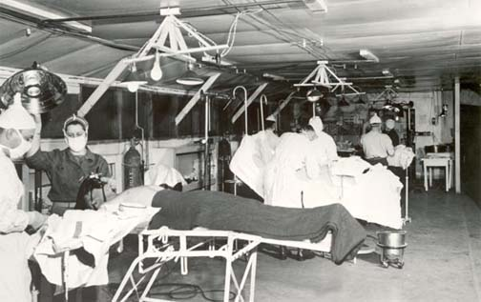
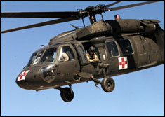
Do Not Attack Medical Personnel, Facilities, Or Equipment
Do not attack people, vehicles, or places marked with these symbols.
Hospitals don’t lose protected status if fortified strictly for defense:
OK for hospital to have armed sentries, Doctors to have sidearms.
Not OK to co-locate hospital with SAM site, or to hide large weapons supplies there.
Hospitals, medics, or medical vehicles CAN lose their protected status if they are used improperly.
Notes:
Instructor Comments
Warning requirements exist before certain medical units, vessels, or facilities forfeit their protection from being made the object of attack. (DoD LoWM para. 5.11.5.1) However, units may return fire in self-defense (See DoD LoWM para. 7.17.1.2, 7.10.3.2).
There are three recognized medical marking emblems under the Geneva Conventions and Protocol III: the Red Cross, Red Crescent and Red Crystal. See GC I, Art. 38 and Protocol III of the Geneva Conventions dated 8 December 2005. The crystal may be used alone or may incorporate another recognized symbol in accordance with Article 3 of Protocol III. These symbols may be affixed to buildings, vehicles, aircraft, and armbands. Objects or individuals marked with these symbols are to be respected and protected from attack. GC I, Art. 19. However, if these symbols are misused to commit “acts harmful to the enemy,” then the protection they afford is forfeited. GC I, Art. 21.
Medical symbols can be misused:
Medical personnel lose protected status if they take direct role in combat
Marked ambulance vehicles should not be armed (no tanks w/ medical markings)
The fact that sick or wounded members of the armed forces are nursed in these hospitals, or the presence of small arms and ammunition taken from such combatants and not yet handed to the proper service, shall not be considered acts harmful to the enemy. DoD LoWM Section 7.17.1.1.

Slide 28
#6: Destroy No More Than The Mission Requires
Only target legitimate military objectives.
Avoid excessive or wanton destruction of property.
Minimize collateral damage.
Protect civilian property.
Protect historic and cultural sites.
Remember: During OIF, our focus was the Iraqi regime, not the people. The more you destroy in battle, the more we’ll have to help rebuild in peace.
Notes:
Instructor Comments
Don’t target or attack what isn’t required to accomplish a mission or achieve a military objective. The attack or bombardment, by whatever means, of towns, villages, dwellings, or buildings which are undefended is prohibited. HR, Art. 25.
As discussed earlier, limit attacks to military objectives— i.e., combatants, and those objects which by their nature, location, purpose, or use make an effective contribution to military action and whose total or partial destruction, capture or neutralization, in the circumstances ruling at the time, offers a definite military advantage—are permissible objects of attack (including bombardment). Military objectives include, for example, factories producing munitions and military supplies, military camps, warehouses storing munitions and military supplies, ports and railroads being used for the transportation of military supplies, and other places that are for the accommodation of troops or the support of military operations. FM 6-27, para. 2-56.
Soldiers do not engage in destruction for destruction’s sake. Consider effects-based operational planning and remember that in the future, the mission may change and we may be responsible for rebuilding!

Slide 29
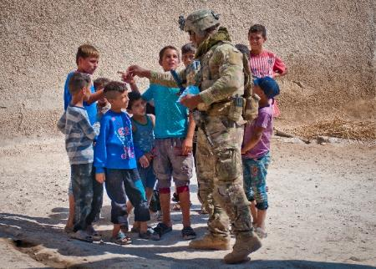
#7: Treat Civilians Humanely
ALL Civilians must be respected.
Never intentionally target civilians
BUT civilians must not take a direct part in hostilities.
You don’t have to stop your mission to care for them
BUT: DO help civilians if safe to do so & it doesn’t interfere with your mission.
Check ROE on collective self-defense
Know what you can and cannot do to defend foreign civilians from hostile acts
Notes:
Instructor Comments
Civilians are to be respected and are not to be made the subject of attack. However, this protection is not absolute and requires civilians to abstain from all hostile acts. Hostile acts are those acts intended to cause actual harm to the personnel and/or equipment of the armed forces (See Note Page, Slide 14, for definition of Hostile Act).
Unless the Rules of Engagement authorize collective self-defense of foreign forces, civilians, property, and interests, always contact local authorities to counter threats to the local population. Per Appendix A of the SROE, CJCSI 3121.01B, only the President or Secretary of Defense may authorize collective self-defense.

Slide 30
Treat Civilians Humanely
No adverse distinction based on race, religion, sex, etc.
No violence to life or person.
No hostage taking.
No degrading treatment.
Must care for the wounded and sick.
Notes:
Instructor Comments
These protections are reflected in what is known as Common Article 3 of the 1949 Geneva Conventions. It is DOD Policy to provide these “minimum” to all DoD detainees. DoDD 2310.01E, DOD DETAINEE PROGRAM.

Slide 31
#8: Do Not Steal!
Soldier who helped commandeer sheik's SUV convicted of armed robbery in court-martial
By Kimberly Hefling ASSOCIATED PRESS
2:11 p.m. July 29, 2004
FORT CAMPBELL, Ky. – A military jury found a soldier guilty of armed robbery Thursday for taking an Iraqi sheik's sport utility vehicle at gunpoint.
He faces up to 15 years in prison. The soldier maintains he helped take the SUV only because his lieutenant ordered him to procure a vehicle and because he did not think it was a criminal act. "In his mind there was nothing wrong with doing it," Bernard Casey, Williams' civilian defense attorney, said in closing arguments Thursday. Army prosecutor Capt. Howard Hoege said Thursday that Williams helped take the SUV at gunpoint from the sheik's son, who was driving the vehicle. Williams then helped orchestrate a cover-up story that the vehicle was found abandoned, Hoege said.
Notes:
Instructor Comments
Anytime property is taken, it must be accounted for with both the property owner and your command. SFC Williams tried to use military necessity as an excuse for taking an SUV from an Iraqi. Further investigation into the incident revealed that SFC Williams did not properly report or account for taking the SUV and then attempted to cover up his actions when he failed to return the vehicle to its owner.

Slide 32
#8: Respect Private Property And Possessions
Civilian Property:
Do not retain unless it is contraband.
The taking of personal property for immediate military necessity or emergency is permissible. Issue a receipt for property taken, when possible.
War trophies:
Do not retain without express authorization from your Commander.
Notes:
Instructor Comments
No pillaging, under any circumstances – and at any location. Geneva Convention Relative to the Protection of Civilian Persons in Time of War Art. 33, Aug. 12, 1949, 6 U.S.T. 3516, 75 U.N.T.S. 287.
Explain Contraband: Any item in the possession of regular, irregular or civilian personnel in an area of operation that is designated by the rules of engagement to be contrary to the successful completion of military operations. The definition of contraband may vary depending upon the theater of operations and the specific mission of the military organization. Examples of contraband include, but are not limited to, personal and crew served weapons and ammunition, explosive devices and materials associated with such devices, and any other designated items whose possession could adversely impact military operations.

Slide 33
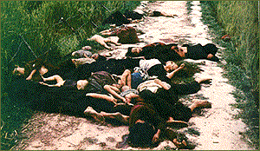
#9: Prevent LOAC Violations
“I was only following orders” and “ambiguous orders” are not defenses to war crimes: My Lai Village, Vietnam, March 1968. Civilian women, children and infants “suspected” of aiding the Vietcong enemy were killed by U.S. forces.
General Dwight D. Eisenhower (center), Supreme Allied Commander, views the corpses of inmates who perished at the Ohrdruf camp. Ohrdruf, Germany, April 12, 1945. (National Archives)
“All that is necessary for the triumph of Evil is for good men to do nothing.”
Notes:
Instructor Comments
On the left, Ohrdruf was the first concentration camp liberated by the Allies in World War II, and was part of the notorious Buchenwald concentration camp network. As the Allies approached, the retreating German guards executed many of their remaining civilian prisoners who were too weak to evacuate.
On the right, in 1968 U.S. Soldiers killed over 300 civilian villagers in My Lai and My Khe, Vietnam—mostly children, women, and elderly. One Platoon Leader, 2LT William Calley, was tried and convicted for murder, though he claimed he was merely following orders and that other orders given were ambiguous. The event haunted those present and severely damaged U.S. credibility during and after the Vietnam conflict.
Moral Courage and Self Discipline are the hallmarks of a Professional Warrior. At My Lai, then-Warrant Officer One Hugh C. Thompson, Jr. landed his helicopter in the line of fire between fleeing Vietnamese civilians and those pursuing them. He confronted LT Calley, helped evacuate several civilians, and reported the massacre to his superiors, prompting an order to cease fire. Though initially criticized and threatened, Thompson and others later received the Soldier’s Medal for their personal courage and ethical conduct that stopped a massacre.

Slide 34
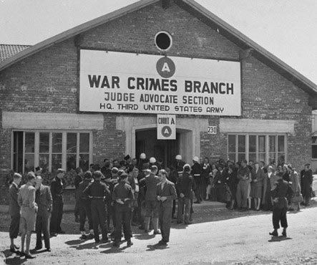
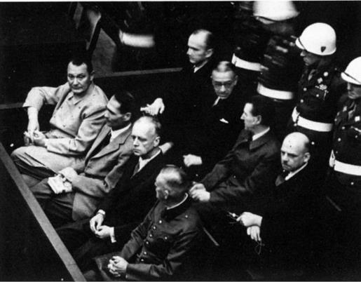
#10: Report All LOAC Violations
Report ALL suspected LOAC violations (enemy or friendly) to your chain of command.
You may also report through other channels, including the military police, a judge advocate, an inspector general, or a chaplain.
It is your duty to know the LOAC and follow the rules.
If you are ordered to commit a criminal act or LOAC violation, you are under an obligation to refuse the order.
“I was just following orders” is NOT a defense to war crimes.
Notes:
Instructor Comments
When it comes to war crimes, “I was just following orders” is not a defense. DoDD 2311.01E and Army policy require you to report known or suspected violations of LOAC to your chain of command, whether committed by U.S. or other forces. Your chain of command will initiate an investigation into what happened.
If you are not comfortable going through your chain of command, go to the JAG, the IG, or the Chaplain to report the incident.
The fact that there is an investigation does not automatically mean someone is in trouble. Often, an investigation helps the command identify changes in policy or training that make us stronger and better as a fighting force. It may also exonerate Servicemembers against inaccurate allegations, or prove they did the right thing, and documents what happened in case the same allegation comes up six months later. One thing is true though—covering up or interfering with an investigation is itself a crime.
It is not easy to speak up, but the truth is worth telling. Ask for clarification of an order that appears illegal. Do not follow orders you know violate the LOAC or are otherwise illegal. Do your best to prevent LOAC violations, and report those you see or hear about.

Slide 35
Summary
Understand & Obey the LOAC.
It’s your duty & it’s the law!
Act based on Military Necessity.
Avoid Causing Unnecessary Suffering.
Only attack military objectives, not civilians or civilian objects.
Minimize Collateral Damage.
Follow The Ten Soldier’s Rules.
Return with Honor!
Notes:
Instructor Comments
Today we discussed the need for the law of armed conflict, the LOAC’s sources and purpose, and its four major principles. We also reviewed the Soldier’s Rules, particularly the requirements to treat detainees and civilians humanely, and to prevent and report LOAC violations.
[If you have prepared a handout, or tailored this briefing to a particular mission or theater, emphasize these now, and/or give time to the Commander or senior enlisted present to offer their final thoughts.]

Slide 36
Questions?
Notes:
Instruction Note:
Questions or comments about this briefing may be referred to the Educational Technology Distributed Learning Division, The Judge Advocate General’s Legal Center and School by going to https://jagu.army.mil and submitting a helpdesk ticket.

